Slide 1

A2A Protocol (Agent to Agent)
Overview
Mangesh Shanbhag

Slide 2
Disclaimer
  The information in this presentation is confidential and proprietary to SAP and may not be disclosed without the permission of SAP.
  Except for your obligation to protect confidential information, this presentation is not subject to your license agreement or any other service
  or subscription agreement with SAP. SAP has no obligation to pursue any course of business outlined in this presentation or any related document, or to develop or release any functionality mentioned therein.
  This presentation, or any related document and SAP's strategy and possible future developments, products and or platforms directions and functionality are all subject to change and may be changed by SAP at any time for any reason without notice. The information in this presentation is not a commitment, promise or legal obligation to deliver any material, code or functionality. This presentation is provided without a warranty of any kind, either express or implied, including but not limited to, the implied warranties of merchantability, fitness for a particular purpose, or non-infringement. This presentation is for informational purposes and may not be incorporated into a contract. SAP assumes no responsibility for errors or omissions in this presentation, except if such damages were caused by SAP’s intentional or gross negligence.
  All forward-looking statements are subject to various risks and uncertainties that could cause actual results to differ materially from expectations. Readers are cautioned not to place undue reliance on these forward-looking statements, which speak only as of their dates,
  and they should not be relied upon in making purchasing decisions.

Slide 3
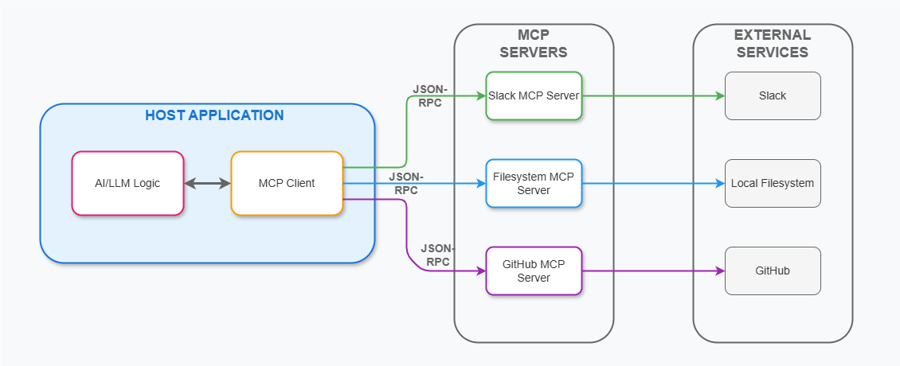
MCP Protocol
MCP Server1
API
MCP Server2
Database
MCP Server3
Web tools

Slide 4
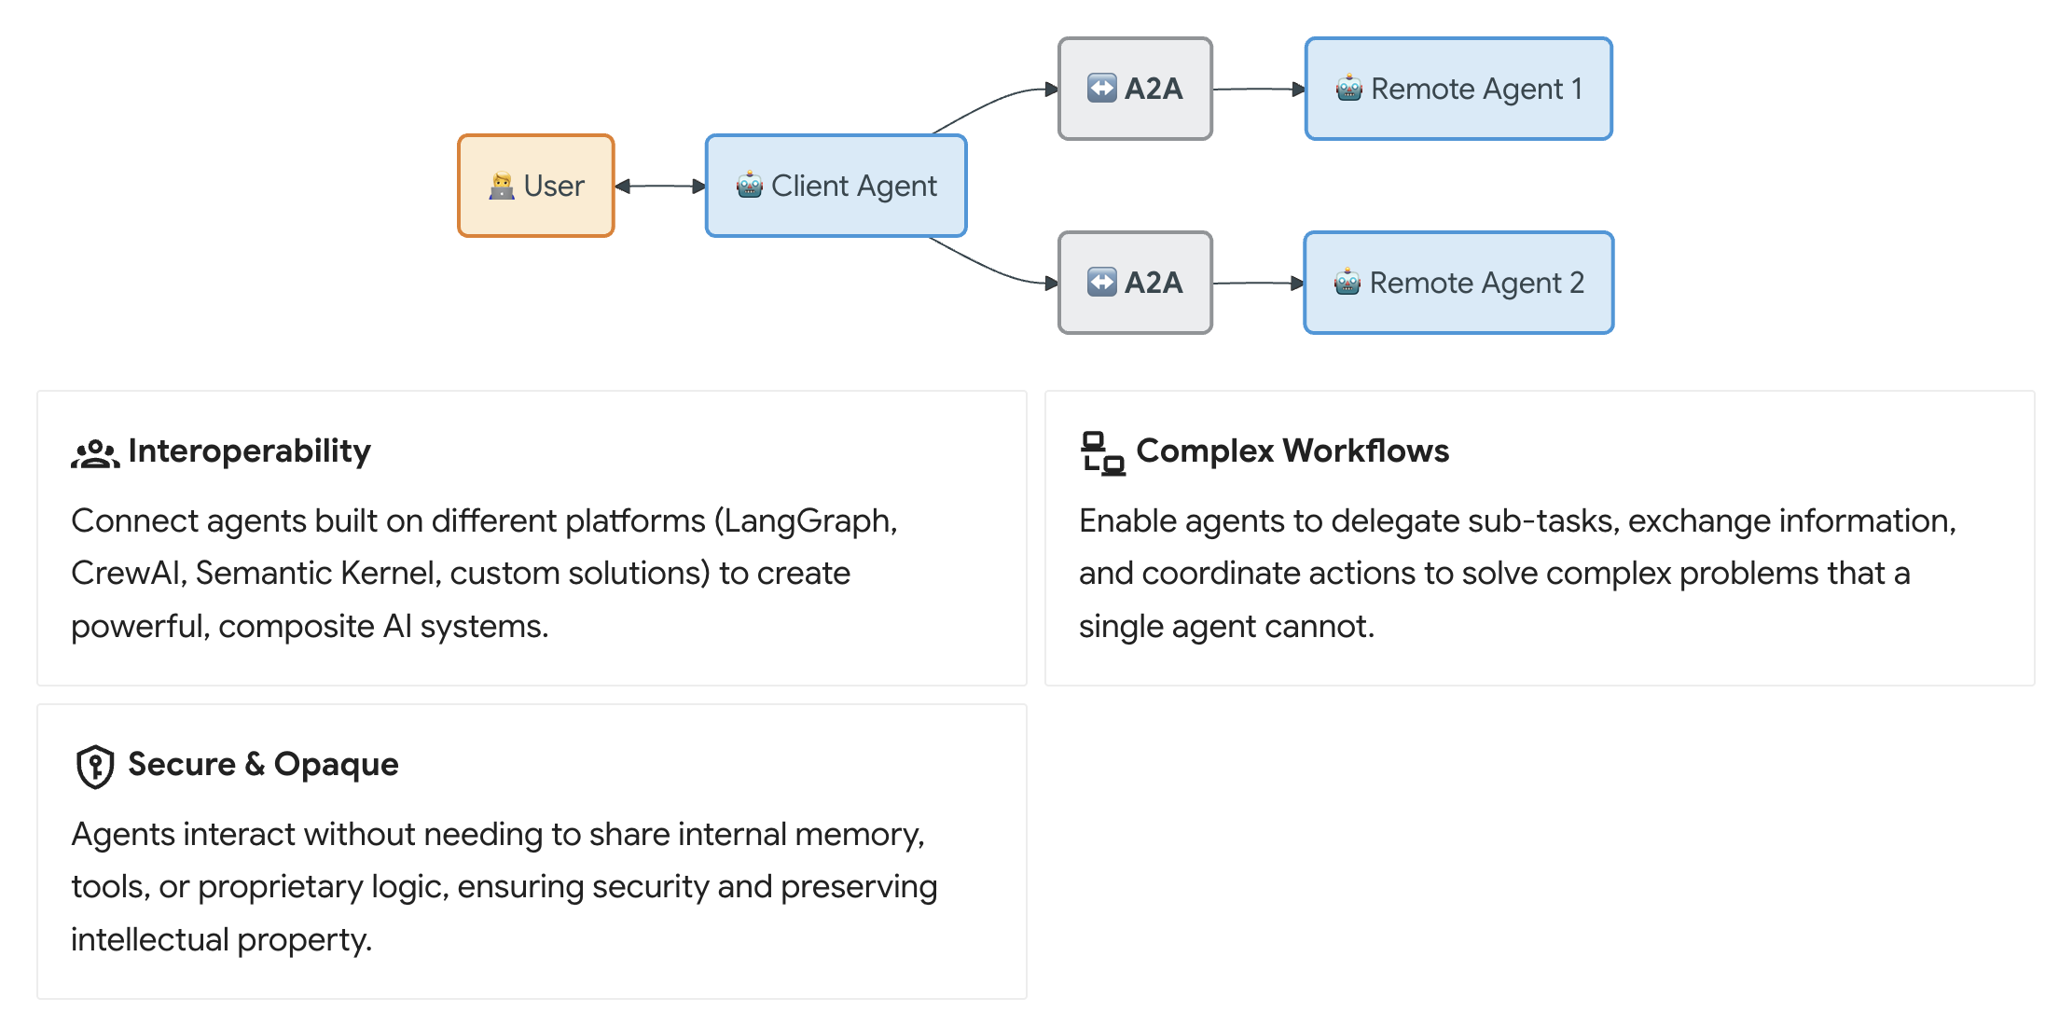
A2A Protocol
A2A is an open protocol that provides a standard way for agents to collaborate with each other, regardless of the underlying framework or vendor.

Slide 5
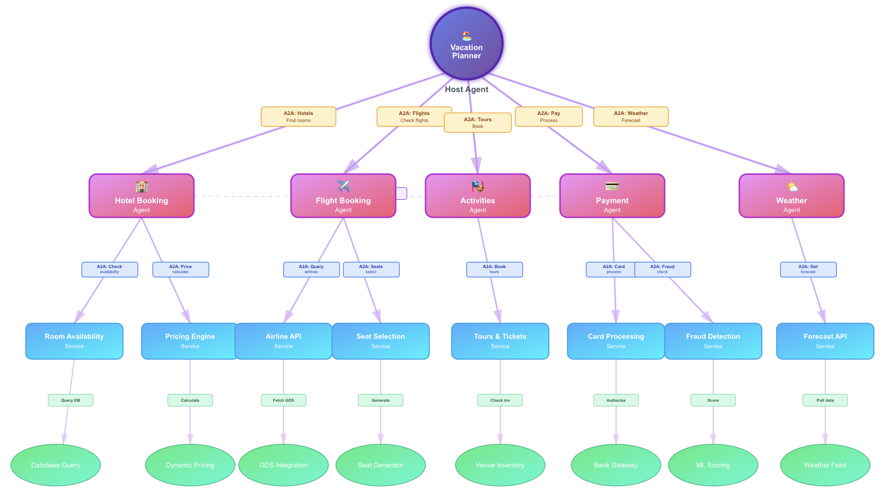
A solution with A2A

Slide 6
A2A – Fundamental Components
A2A Client (Client Agent)
The client initiates communication using the A2A protocol.
A2A Server (Remote Agent)
The Server which receives HTTP requests from clients, processes tasks, and returns results or status updates.
Key Elements
 | Description | Key Purpose
Agent Card | A JSON metadata document describing an agent's identity, capabilities, endpoint, skills, and authentication requirements. | Enables clients to discover agents and understand how to interact with them securely and effectively.
Task | A stateful unit of work initiated by an agent, with a unique ID and defined lifecycle. | Facilitates tracking of long-running operations and enables multi-turn interactions and collaboration.
Message | A single turn of communication between a client and an agent, containing content and a role ("user" or "agent"). | Conveys instructions, context, questions, answers, or status updates that are not necessarily formal artifacts.
Part | The fundamental content container (for example, TextPart, FilePart, DataPart) used within Messages and Artifacts. Example – Instruction, Query, File, Json Document, Text Summary etc. | Provides flexibility for agents to exchange various content types within messages and artifacts.
Artifact | A tangible output generated by an agent during a task. Example –Documents, Files, Images, Data models, Visualizations, Summaries, Reports, or generated code | Delivers the concrete results of an agent's work.
Notes:
Core Benefits of A2A¶
Implementing the A2A protocol offers significant advantages across the AI ecosystem:
Secure collaboration: Without a standard, it's difficult to ensure secure communication between agents. A2A uses HTTPS for secure communication and maintains opaque operations, so agents can't see the inner workings of other agents during collaboration.
Interoperability: A2A breaks down silos between different AI agent ecosystems, enabling agents from various vendors and frameworks to work together seamlessly.
Agent autonomy: A2A allows agents to retain their individual capabilities and act as autonomous entities while collaborating with other agents.
Reduced integration complexity: The protocol standardizes agent communication, enabling teams to focus on the unique value their agents provide.
Support for LRO: The protocol supports long-running operations (LRO) and streaming with Server-Sent Events (SSE) and asynchronous execution.

Slide 7
A2A – Landscape
A2A Server
AGENT CARD
name: ”Hotel Booking Agent",
description: “handles hotel booking”
url: ”https://192.168.33.23”
capabilities: [ searchHotels,
getHotelDetails,
createBooking,
cancelBooking,
getBookingStatus
]
Agent Executor
/execute
/cancel
Discover Capabilities
Agent 1
HTTPS
Message
Host Agent
A2A Client
https://192.168.33.23
Message
A2A Server
AGENT CARD
name: ”Flight Booking Agent",
description: “handles flight booking”
url: ”https://192.168.33.23”
capabilities: [ searchFlights,
getFlightDetails,
createBooking,
cancelBooking,
getBookingStatus
]
Agent 1 : https://192.168.33.23
Agent 2 : https://192.168.11.22
Agent Executor
HTTPS
/execute
/cancel
Discover Capabilities
Agent 2
https://192.168.11.22

Slide 8
A2A – Communication
Host Agent
A2A Client
A2A Server
1
Get Agent Card
2
name:
”Hotel Booking Agent",
description:
“handles hotel booking”
url:
”https://192.168.33.23”
capabilities:
[ searchHotels,
getHotelDetails,
createBooking,
cancelBooking,
getBookingStatus
]
Agent Executor
Agent 1
TOOLS
searchHotels
getHotelDetails
createBooking
cancelBooking
getBookingStatus
3
Execute [Search Hotels]
4
Result: [Hotels]

Slide 9
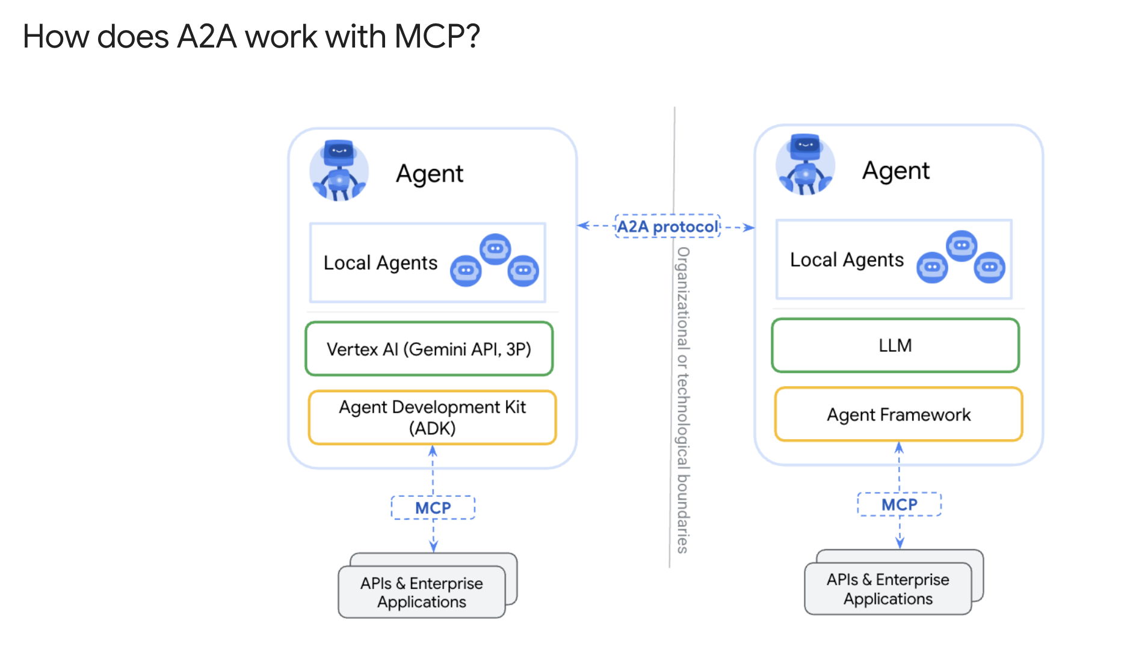

Slide 10
Demo

Slide 11
Thank You

